Slide 1

Department of Information Technology
NBA Accredited A.P. Shah Institute of Technology G. B. Road, Kasarvadavli, Thane(W), Mumbai-400615 UNIVERSITY OF MUMBAI Academic Year 2021-2022

Slide 2
A Project Report on Using AR/VR For Shopping Submitted in partial fulfillment of the degree of Bachelor of Engineering(Sem-8) in INFORMATION TECHNOLOGY By Jaaie Kadam(18104017) Prachi Manera(17104013)] Under the Guidance of Prof. Anagha Aher

Slide 3
1.Project Conception and Initiation

Slide 4
1.1 Abstract
The COVID-19 virus outbreak began in December 2019 and rapidly spread to every continent on Earth. The analysts have predicted that COVID-19 and other similar pandemics will continue in the coming decade and badly affect offline businesses. As a result, the offline platform is also shifting to the online platform and online demands are increasing daily. The traditional two-dimensional E-Commerce websites are designed to provide simple, browser-based interfaces to allow users to access available products and services. Whilst virtual representations are an essential consideration in establishing trust, most virtual representation sites fall short in mimicking real-life human representation.

Slide 5
1.2 Objectives
To develop an android application.
To advance the current Shopping system by providing user an immersive experience.
To understand the concepts of VR and Unity and develop a prototype using the findings.
To create the database for the retail items, shops and customers, demonstrating their relationships through queries and functions on the user interface.

Slide 6

2. Literature Review
Sr. No. | Paper name and Authors | Findings
1. | G. M. Nielson and D. R. Olsen, "Direct manipulation techniques for 3d objects using 2d locator devices“1987. | Mouse and Keyboard : The ability to map a 2D mouse inter-action to a 3D space.
2. | A. Kitson, B. E. Riecke, A. M. Hashemian, and C. Neustaedter , “ Navichair: Evaluating an embodied interface using a pointing task to navigate virtual reality” 2015. | Specialized equipment: gaming input devices – joysticks and pads – or dedicated VR devices – tracked controllers and haptic arms – gives high user comfort and good accuracy.

Slide 7
Sr. No. | Paper name and Authors | Findings
3. | S. Gebhardt, S. Pick, H. Voet, J. Utsch, T. al Khawli, U. Eppelt, R. Reinhard, C. Bscher, B. Hentschel, and T. W. Kuhlen, “flapassist: How the integration of vr and visualization tools fosters the factory planning process,”2015. | Context-based approach is an interaction technique popular in computer games, in particular simulations (e.g., ”The Sims” and ”SimCity” series by Maxis)and adventure games.
4. | •J. Sokołowski and K. Walczak, “Semantic modelling of user Interactions in virtual reality environments,” 2018. | CAVE (Cave automatic virtual enviornment)

Slide 8
1.4 Problem Definition
Problem Identified
With the 2D shopping websites used today, they have their natural limitations, which is a particularly important element of shopping.
Malls and grocery shops are closed or there are many restrictions imposed on them due to ongoing pandemic.
Solution Proposed
We proposed creating a VR-based android application that would overcome the limitations of 2d shopping, such as a lack of "touch and feel" and uncertainty about product details. Users will be able to shop virtually in a brick-and-mortar setting from the comforts of their own homes.

Slide 9
1.5 Scope
Can be used to make the use of immersive VR systems simpler for non-expert users, and therefore applicable in more application domains.
Can be used to achieve a user-friendly content management by domain experts.
Can be used to simulate in the real world environment and give the customer a flexibility to engage with the activities that are closer to experiencing the products and services.

Slide 10
1.6 Technology stack
Software Constraint
Platform used:-Windows 10
Unity
Mongo DB
Node JS
Hardware Requirement
Laptop or computer
Processor:-Intel core i3
RAM:-8GB
Front End
Bootstrap, HTML, CSS, jQuery, JS:- Used to develop a website.
Google cardboard: for running the VR applications in real-time.

Slide 11
1.7 Benefits for environment & Society
VR lets customers take their shopping experience outside of the store.
Shoppers could explore a virtual store, picking up and examining items in 3D before deciding to purchase them with just a look.
Visualising products online with an added element of personalisation lets people fully engage and invest in your business.
People can shop like they do in brick-and-mortar stores from the comfort of their own homes if another pandemic strikes.

Slide 12
2. Project Design

Slide 13
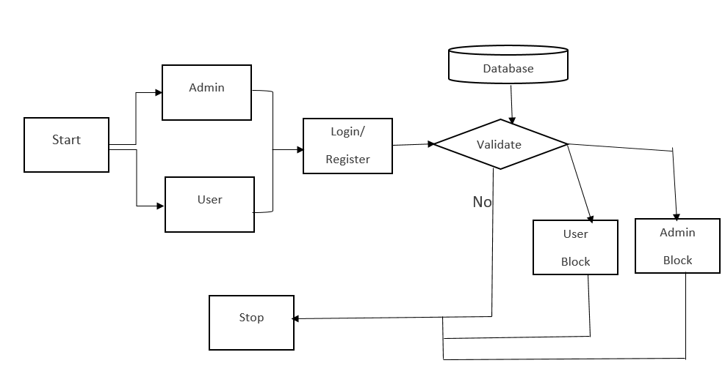
2.1 Proposed System

Slide 14
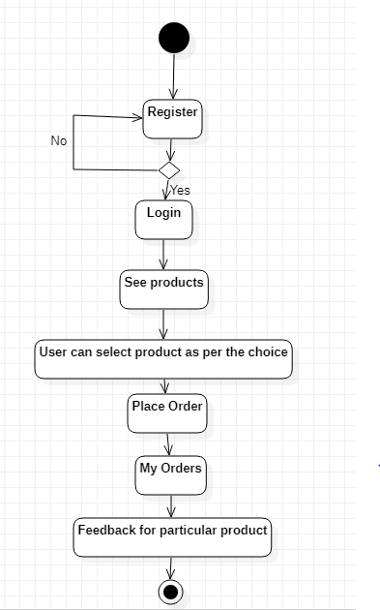
2.2 Design(Flow Of Application)
Notes:
14

Slide 15
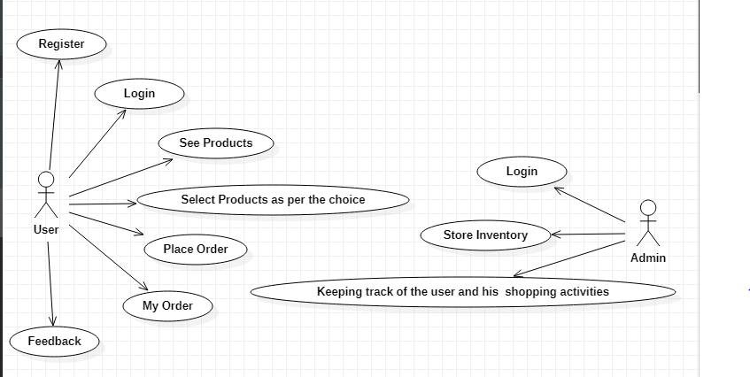
2.3 Use Case for V-Mart App

Slide 16
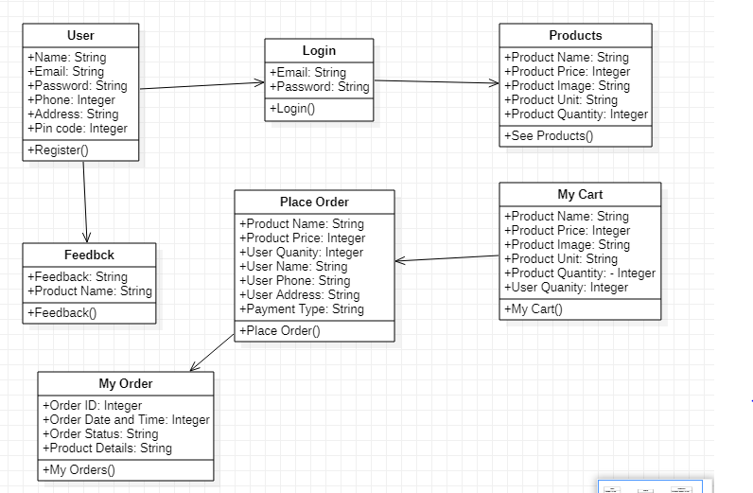
2.5 Class Diagram for V-Mart App

Slide 17
3. Implementation

Slide 18
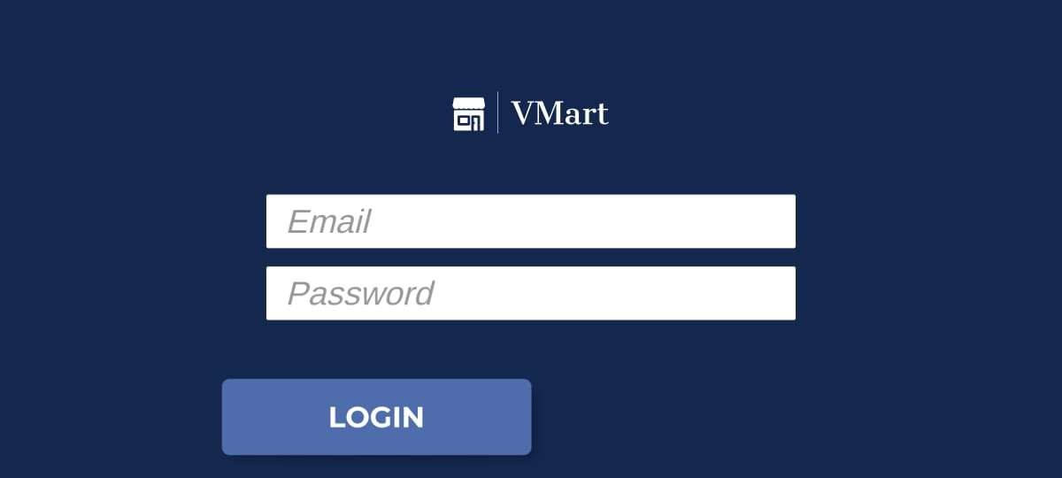
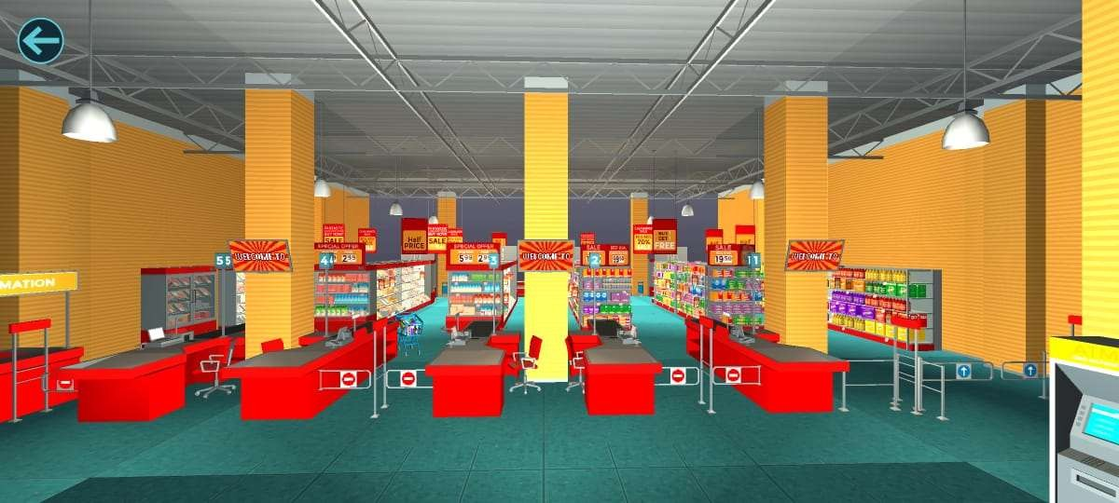
3.1 V-Mart Application

Slide 19
Adding products to cart

Slide 20
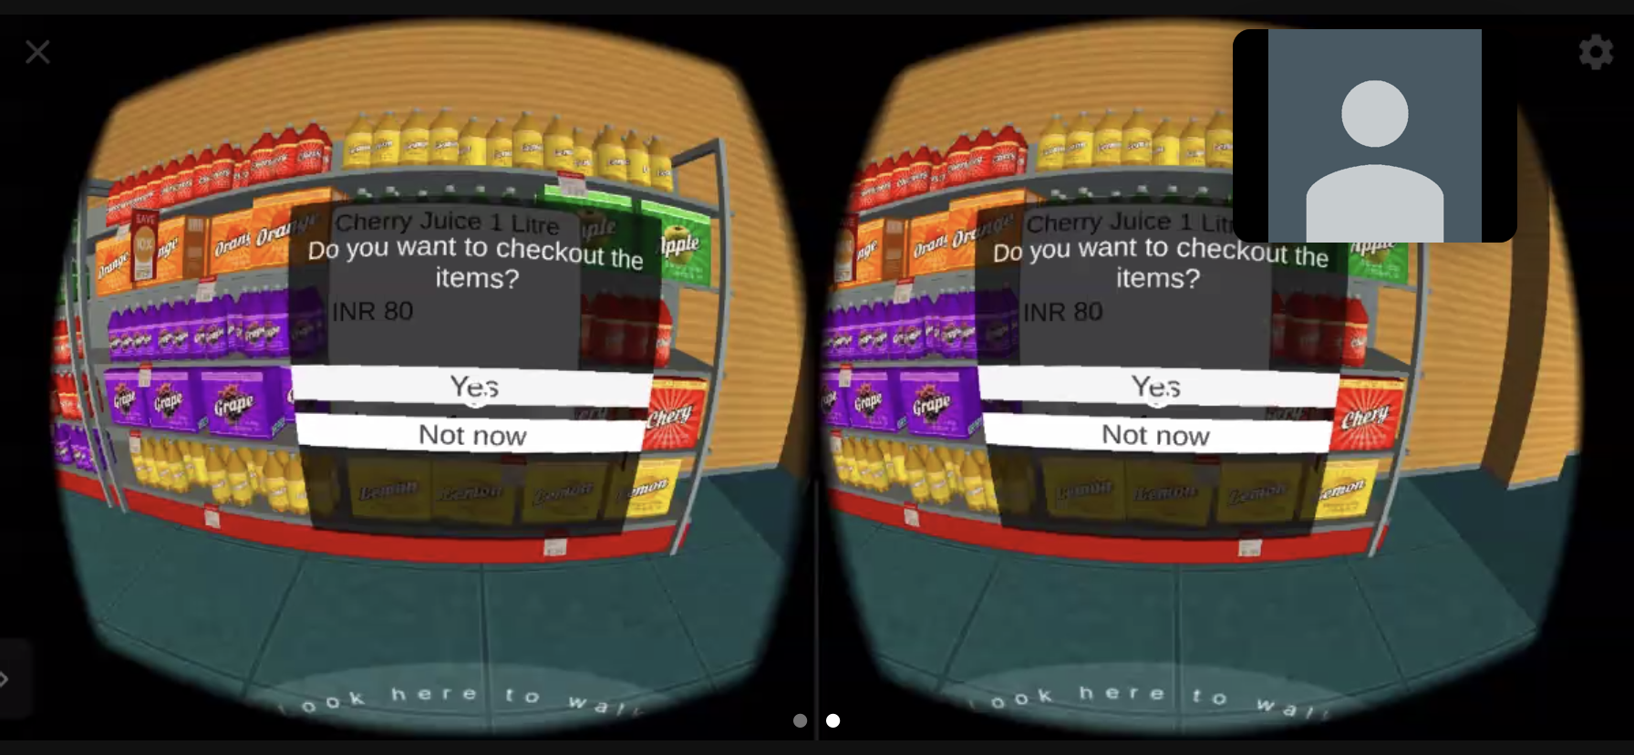
Checkout Activity

Slide 21
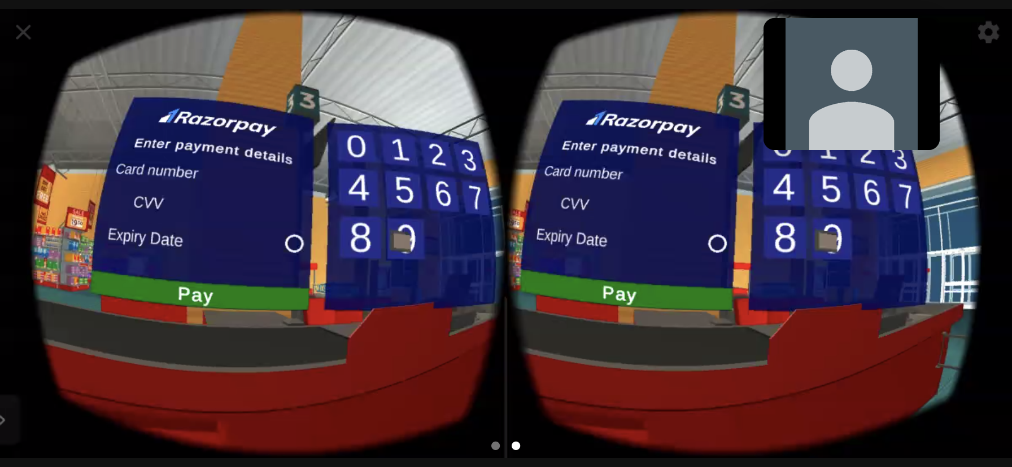
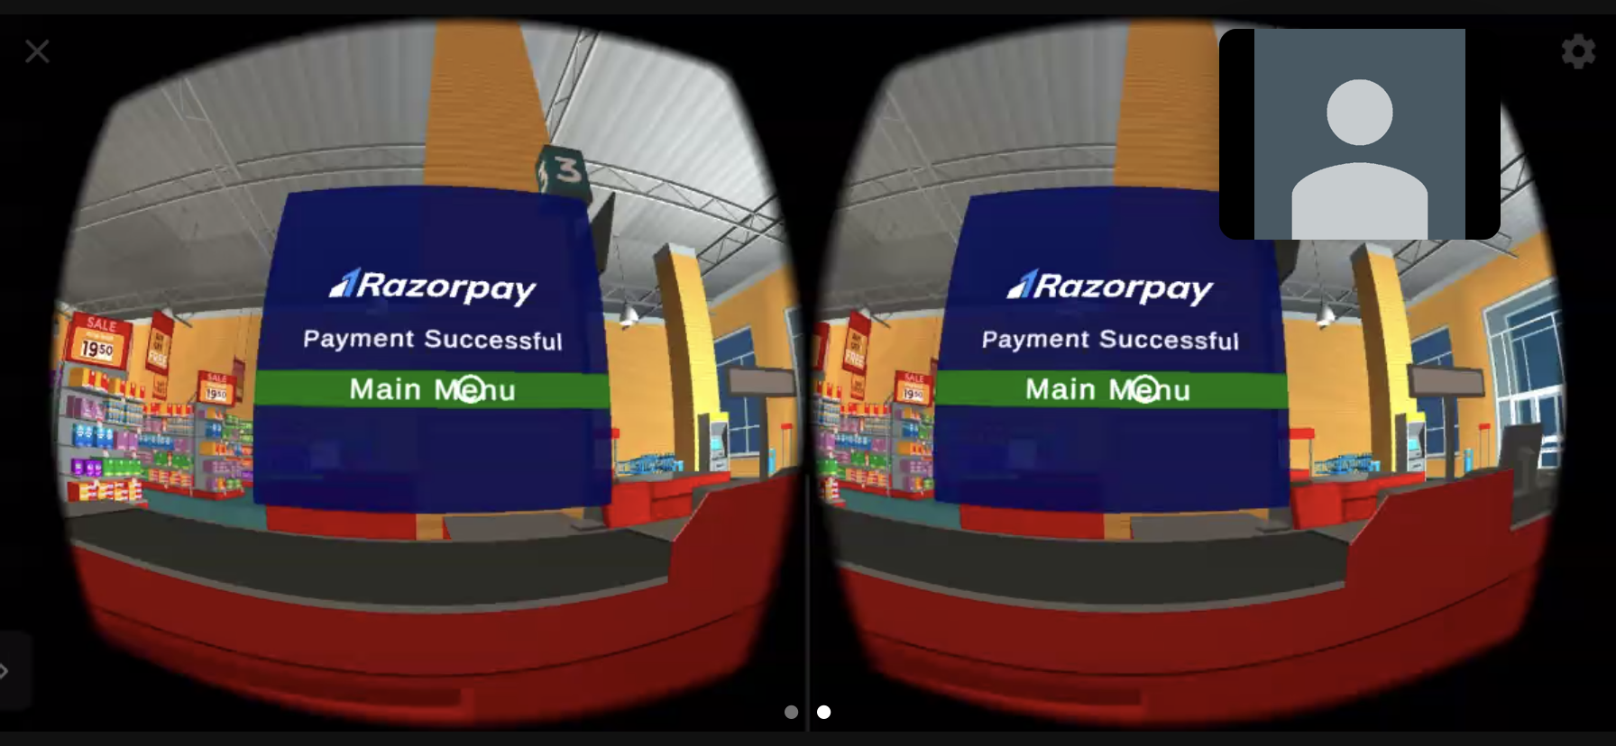
Payment Activity

Slide 22
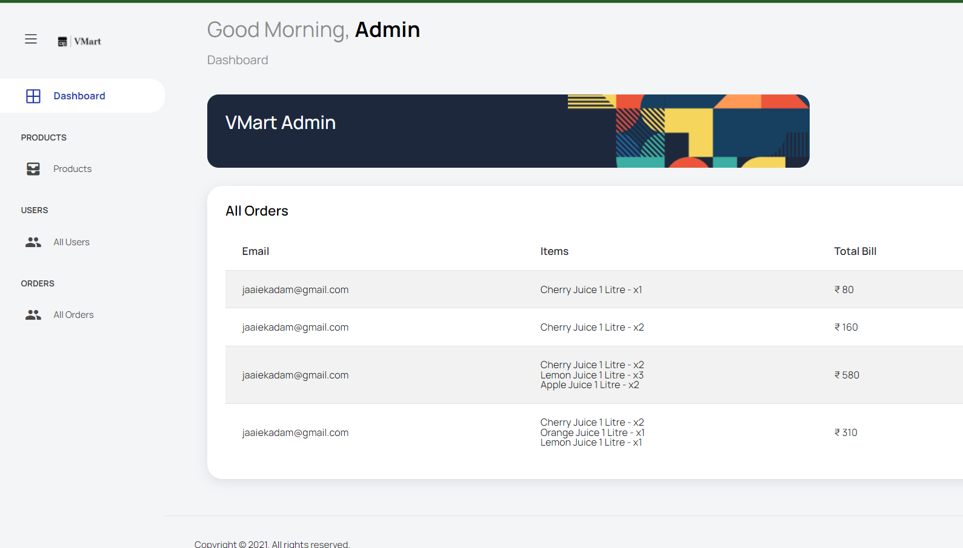
3.2 V-Mart Admin Dashboard

Slide 23
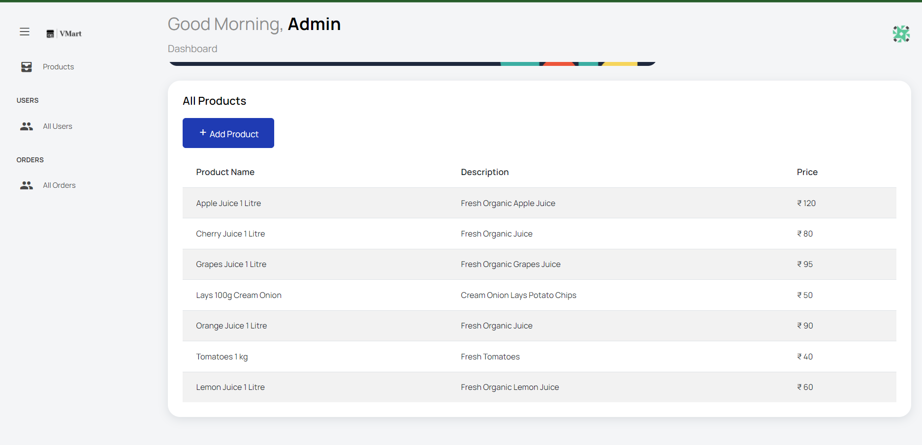

Slide 24
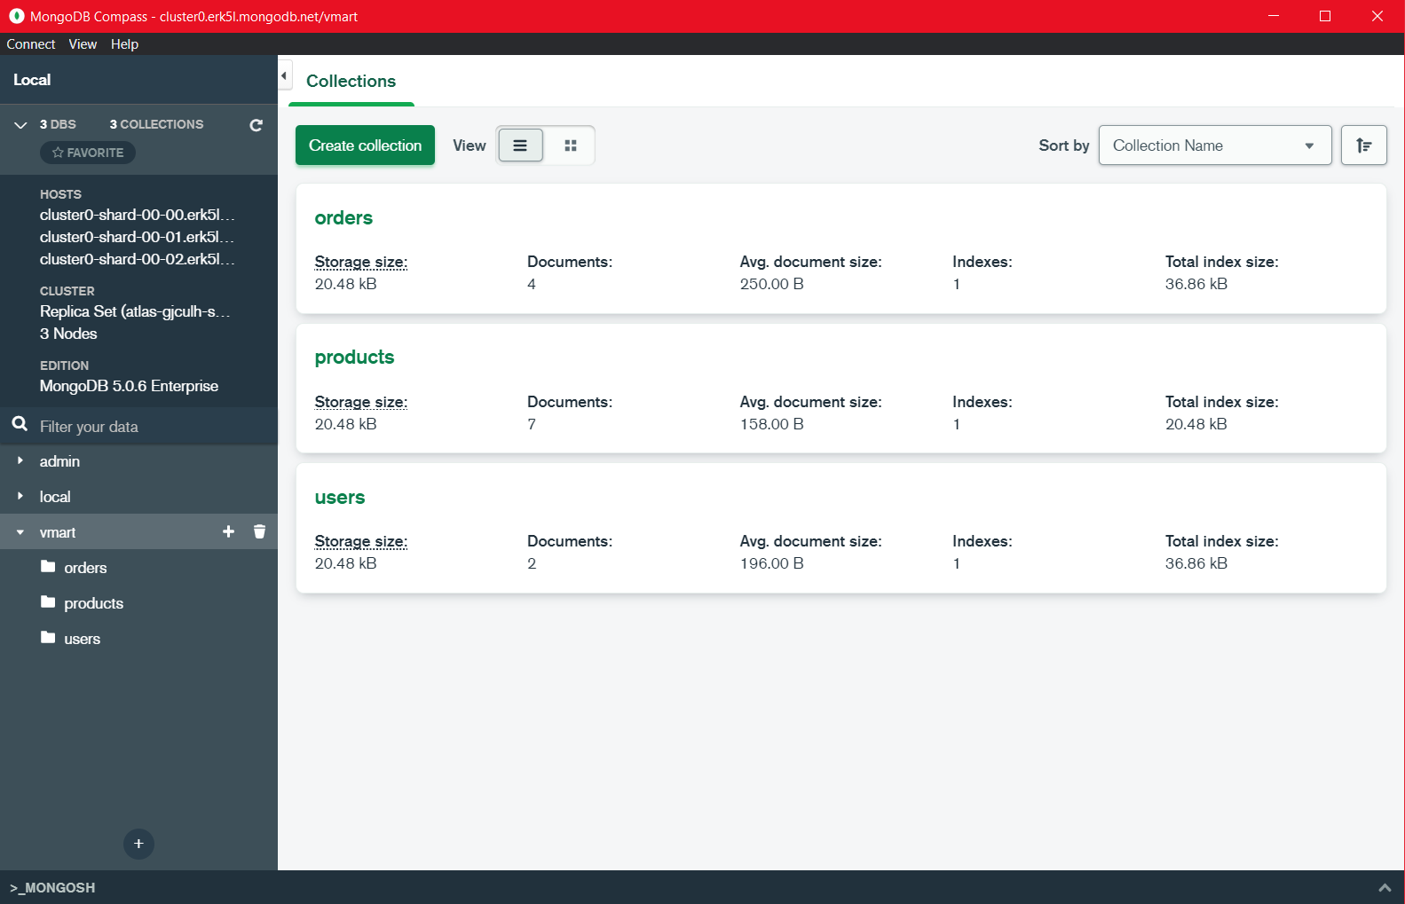
3.3 V-Mart Database

Slide 25
4. Testing

Slide 26
Unit Testing:-
Unit testing is the testing of an individual unit or group of related units. It falls under the class of white box testing. It is often done by the programmer to test that the unit he/she has implemented is producing expected output against given input. In this application actual functionality is place order. In this application user can see multiple products. Unit testing checks that whether the products appear in the screen or not. User can select their products as per the choice. After that they can place the order. Unit testing checks that whether the order is placed or not.
Integration Testing:-
Integration testing is to check whether the application is working or not. In VR shopping application every feature is check. After unit testing each module, all the modules are tested simultaneously. In VR shopping application the first activity is login screen. If the he/she is new user then they need to first register themselves. If the user login is successfully then only user can see products. Integration testing checks that whether the products appear in the screen or not. User can select their products as per the choice. After that they can place the order. Integration testing checks that whether the order is placed or not. Integration testing checks whether the user is able to make payment or not.

Slide 27
5. Result

Slide 28
Test Case ID | Test Case Condition | Input | Expected Result
1. | Enter Name | John Mathew | Field should contain only text
2. | Enter Email | abc@gmail.com | Field can contain all types of characters
3. | Enter password | abc12345 | Field can contain all types of characters
4. | Enter confirm password | abc12354 | Please Confirm the Password
5. | Enter phone number | 9874561230 | Field should contain only numbers
6. | Enter address | 4,Sharda Apartment, Ganesh Nagar,Bhandup (w) | Field should contain text and number
7. | Enter city | Mumbai | Field should contain only text
8. | Enter pin code | 415263 | Field should contain only numbers

Slide 29
Test Case ID | Test Case Condition | Input | Expected Result
9. | If the name, email, password, phone number, address, city and pin code is field empty. | Name:-____________ Email ;-___________ Password:-_________ Confirm Password:___ Address:-________ City:-_____ Pin code:-________ | Please fill all the details.
10. | If the user enter an email without @ sign | johngmail.com | Enter valid email.
11. | If the user enter password is below 8 digit number | 123456 | Password must be 8 digits.
12. | If the password and confirm password do no match | 12345678 b) 1234567 | Please Confirm the Password
13. | If the enter pin code is below 6 digits | 41526 | Pin code must be 6 digits.
14. | If the enter email Id and password is valid | Click on login | Login successfully and home screen will be displayed.
Notes:
29

Slide 30
Test Case ID | Test Case Condition | Input | Expected Result
15. | In my cart, user can see their added products. | User can see their added products | Multiple products will be displayed and user can place the order.
16. | In place order user can see total price and personal details. And user needs to select a payment type. | Total Price:-5000 Payment Type:- Cash/Debit/Net Banking | Order placed successfully.
17. | User can see order status | See orders status | See orders status

Slide 31
6. Conclusion and Future Scope

Slide 32
Users will be able to interact with products in person, inspect them, walk through them, and search for them just like they would in a traditional brick-and-mortar store, with the added benefit of an e-commerce website's search and navigation, all for a reasonable price using a low-cost virtual reality device.
3D virtual fitting technology, also known as virtual fitting technology, can be implemented in the future. This allows consumers to try on garments for size, fit, and style without having to physically wear them.

Slide 33
References
[1] S. Altarteer, V. Charissis, D. Harrison, and W. Chan, ‘‘Development and heuristic evaluation of semiimmersive hand-gestural virtual reality inter-face for luxury brands online stores,’’ in Augmented Reality, Virtual Reality, and Computer Graphics (Lecture Notes in Computer Science). Cham, Switzerland: Springer, 2017, pp. 464–477. doi: 10.1007/978-3-319-60928-7_39.
[2] S. Altarteer, C. Vassilis, D. Harrison, and W. Chan, ‘‘Product customi-sation: Virtual reality and new opportunities for luxury brands online trading,’’ in Proc. 21st Int. Conf. Web3D Technol. Web3D, vol. 16, 2016, pp. 173–174.
[3] D. A. Griffith, R. F. Krampf, and J. W. Palmer. The role of interface in electronic commerce: Consumer involvement with print versus on-line catalogs. International Journal of Electronic Commerce, 5(4):135–153, 2001.
[4] K. C. Lee and N. Chung. Empirical analysis of consumer reaction to the virtual reality shopping mall . Computers in Human Behavior, 24(1):88 – 104, 2008. doi: 10.1016/j.chb.2007.01.018 c
[5] P. Lubos, G. Bruder, and F. Steinicke. Influence of Comfort on 3D Selection Task Performance in Immersive Desktop Setups. Journal of Virtual Reality and Broadcasting (JVRB), 12(2).

Slide 34
References
[6] M. Speicher, S. Cucerca, and A. Kr¨uger. Vrshop: A mobile interactive virtual reality shopping environment combining the benefits of onand offline shopping. Proc. ACM Interact. Mob. Wearable Ubiquitous Technol., 1(3):102:1–102:31, Sept. 2017. doi: 10.1145/3130967
[7] M. Speicher, F. Daiber, S. Gehring, and A. Kr¨uger. Exploring 3d manipulation on large stereoscopic displays. In Proceedings of the 5th ACM International Symposium on Pervasive Displays, PerDis ’16, pp. 59–66. ACM, New York, NY, USA, 2016. doi: 10.1145/2914920.2915018
[8] M. Speicher, F. Daiber, G.-L. Kiefer, and A. Kr¨uger. Exploring task performance and user’s preference of mid-air hand interaction in a 3d docking task experiment. In Proceedings of the 5th Symposium on Spatial User Interaction, SUI ’17, pp. 160–160. ACM, New York, NY, USA, 2017. doi: 10.1145/3131277.3134356
[9] M. Speicher, R. Siegel, and A. Kr¨uger. Productfinder: A location aware product information display for retail environments. In Proceedings of the 6th ACM International Symposium on Pervasive Displays, PerDis ’17, pp. 23:1–23:2. ACM, New York, NY, USA, 2017. doi: 10.1145/ 3078810.3084351

Slide 35
Paper Publication
Paper entitled: " Experimental Study On Virtual-Reality Based Retail Mall Called
V-Mart”, is presented at “ICCIIT-2022 / Journal Name: Elsevier SSRN” by Jaaie Kadam, Prachi Manera.

Slide 36
Thank You

